Slide 1
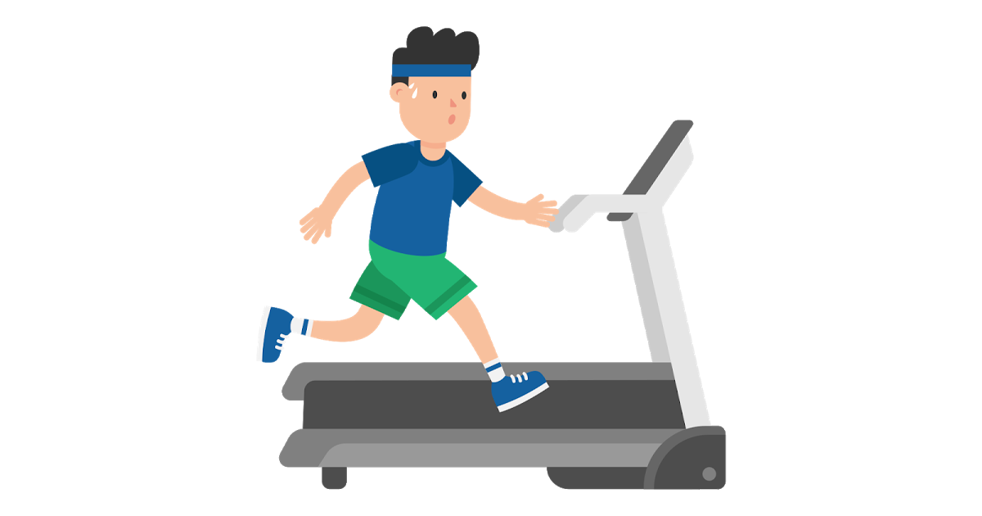
Cardiofitness Treadmill Purchases
Comparison of our company treadmill purchases

Slide 2
Contents of this template
This is a slide structure based on a multi-business presentation
You can delete this slide when you’re done editing the presentation
Beginning | Middle | End
Problem statement We need more profit | Key Plot movements Customer behaviours based on income/fitness/gender | Most important message We have less sell in the third treadmill which could bring more money if sold to more women
Context/Why important? To survive as company or grow | Discovery Less women than we expect buy the third treadmill (The most expensive) | Resolution We need to identify why needs are not met
Hypothesis We do not sell as much as we could | Reframing of a problem statement There is an untapped market we need to reach | Tangible action Rebrand? marketing?

Slide 3
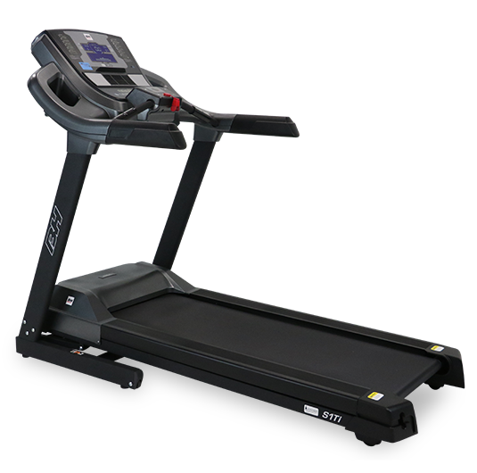
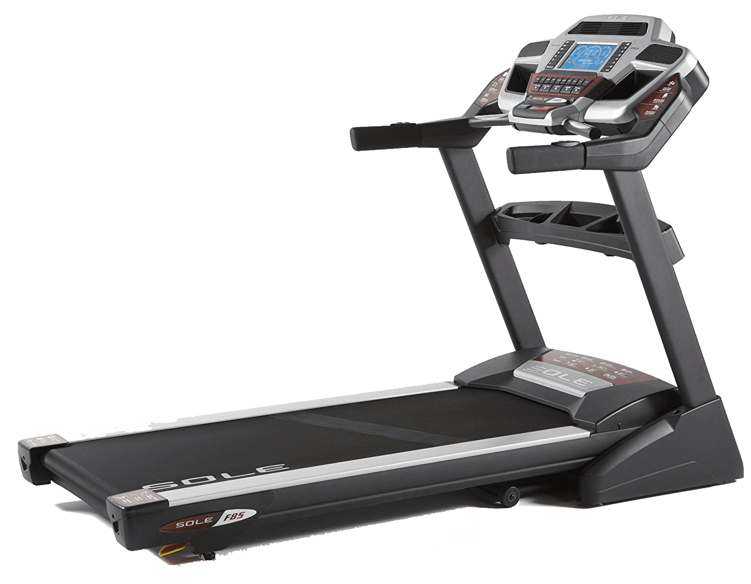
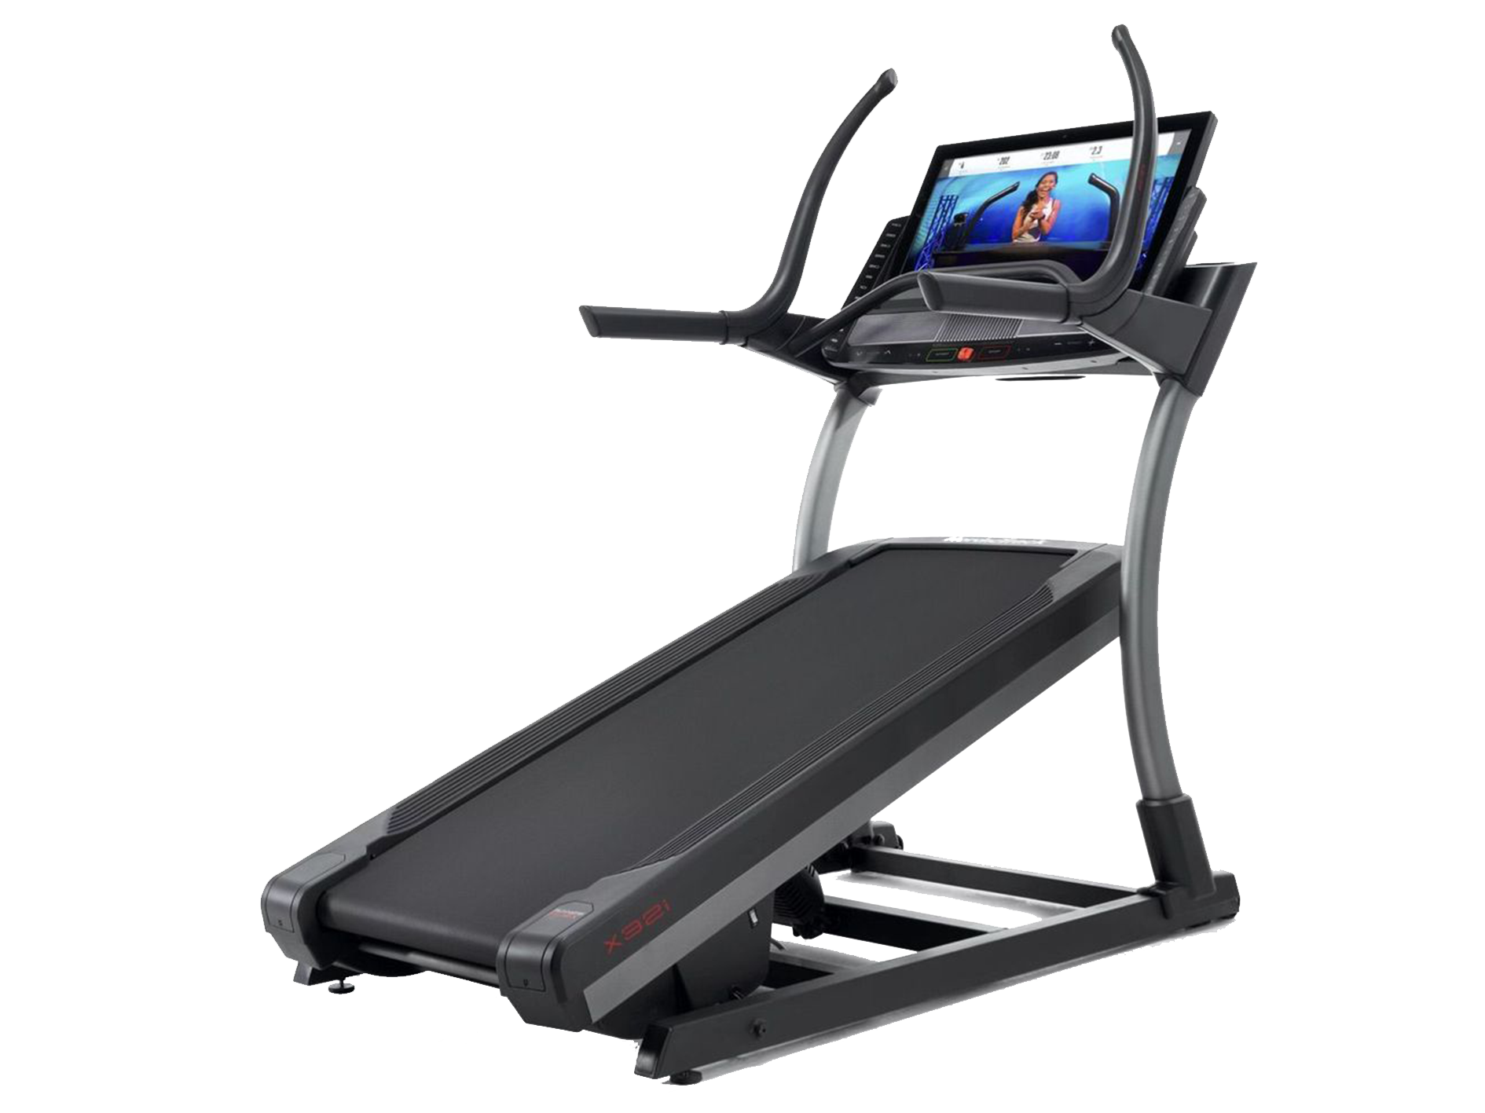
Treadmill Product Analysis
Within the business we have three treadmills that we will be analysing throughout this presentation
TM195
TM498
TM798

Slide 4
Treadmill Product Analysis
Total purchases per product
TM195
TM498
TM798
80
60
40

Slide 5
Insights!
Let’s look further into the sales

Slide 6
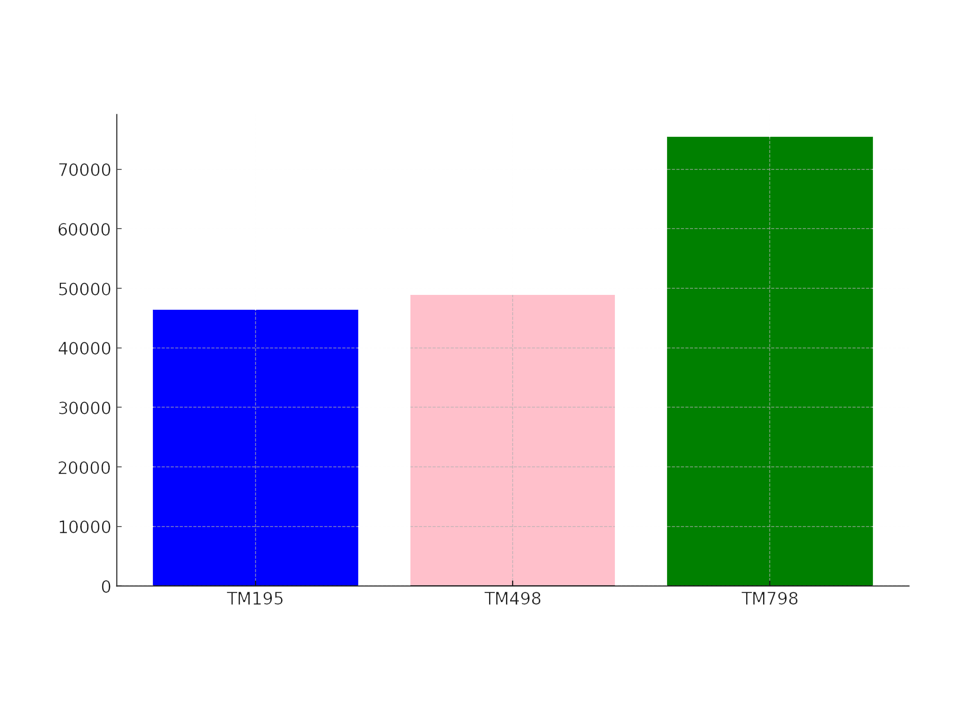
Treadmill Product Analysis
Total purchases per product
By Income
TM798
TM195
TM498

Slide 7
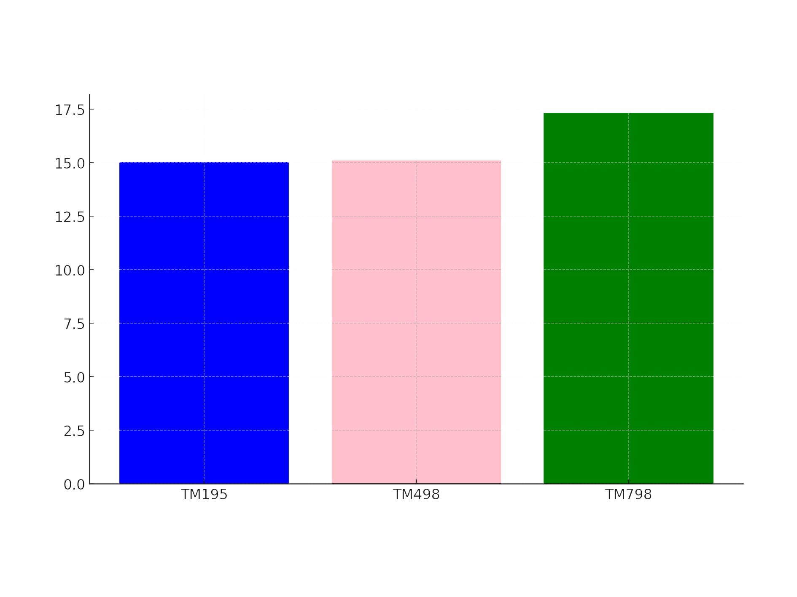
Treadmill Product Analysis
Total purchases per product
By education
TM798
TM195
TM498

Slide 8
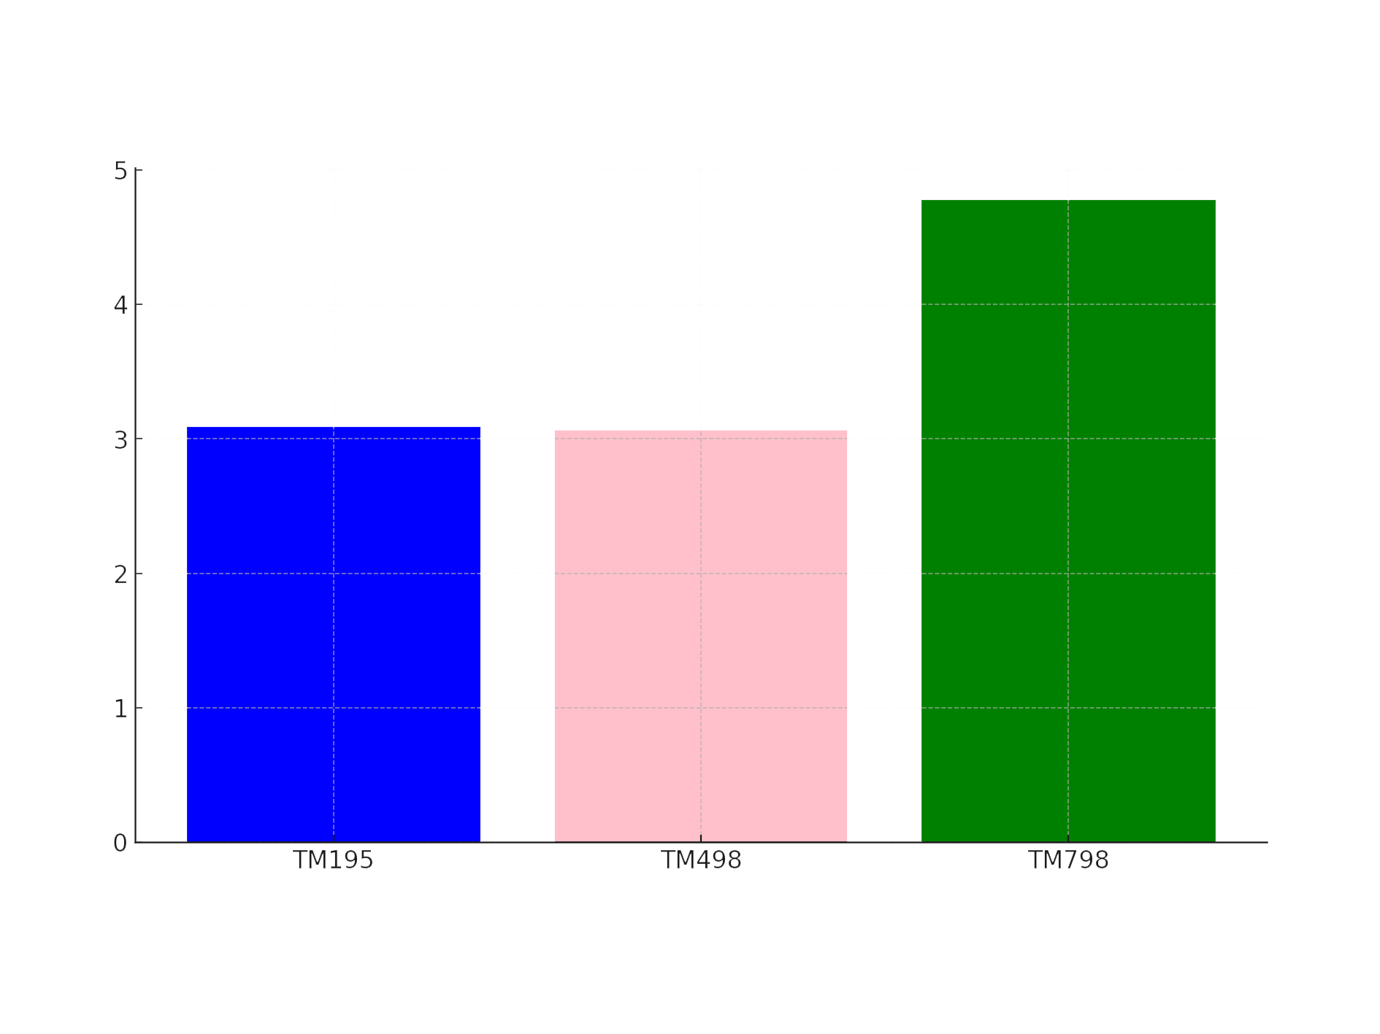
Treadmill Product Analysis
Total purchases per product
By Usage
TM798
TM195
TM498

Slide 9
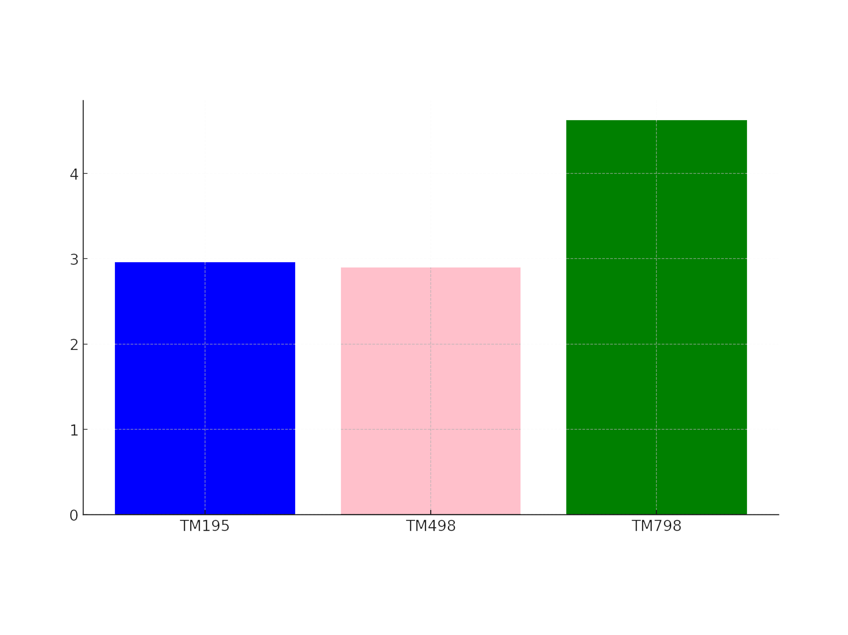
Treadmill Product Analysis
Total purchases per product
By Fitness level
TM798
TM195
TM498

Slide 10
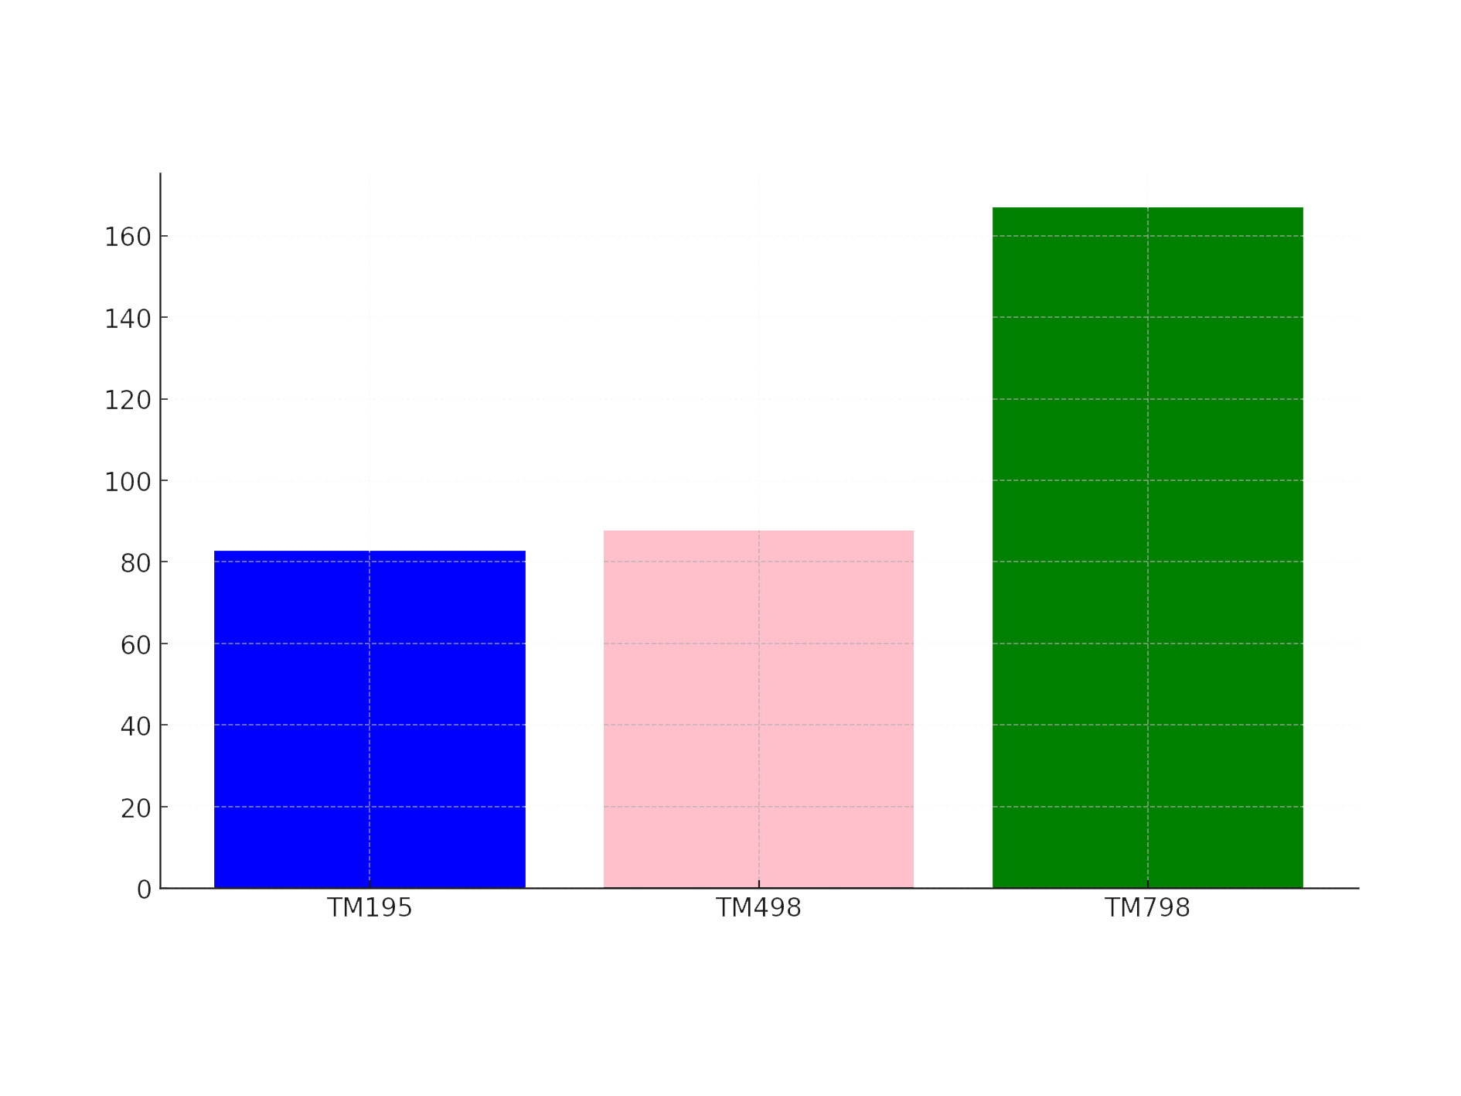
Treadmill Product Analysis
Total purchases per product
by Miles
TM798

Slide 11
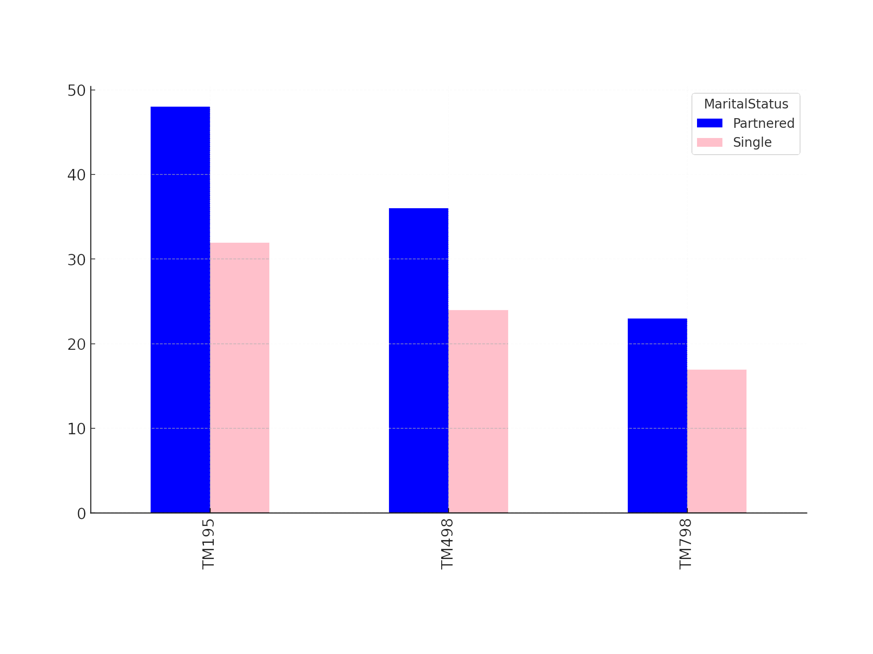
Treadmill Product Analysis
Total purchases per product
by Marital Status

Slide 12
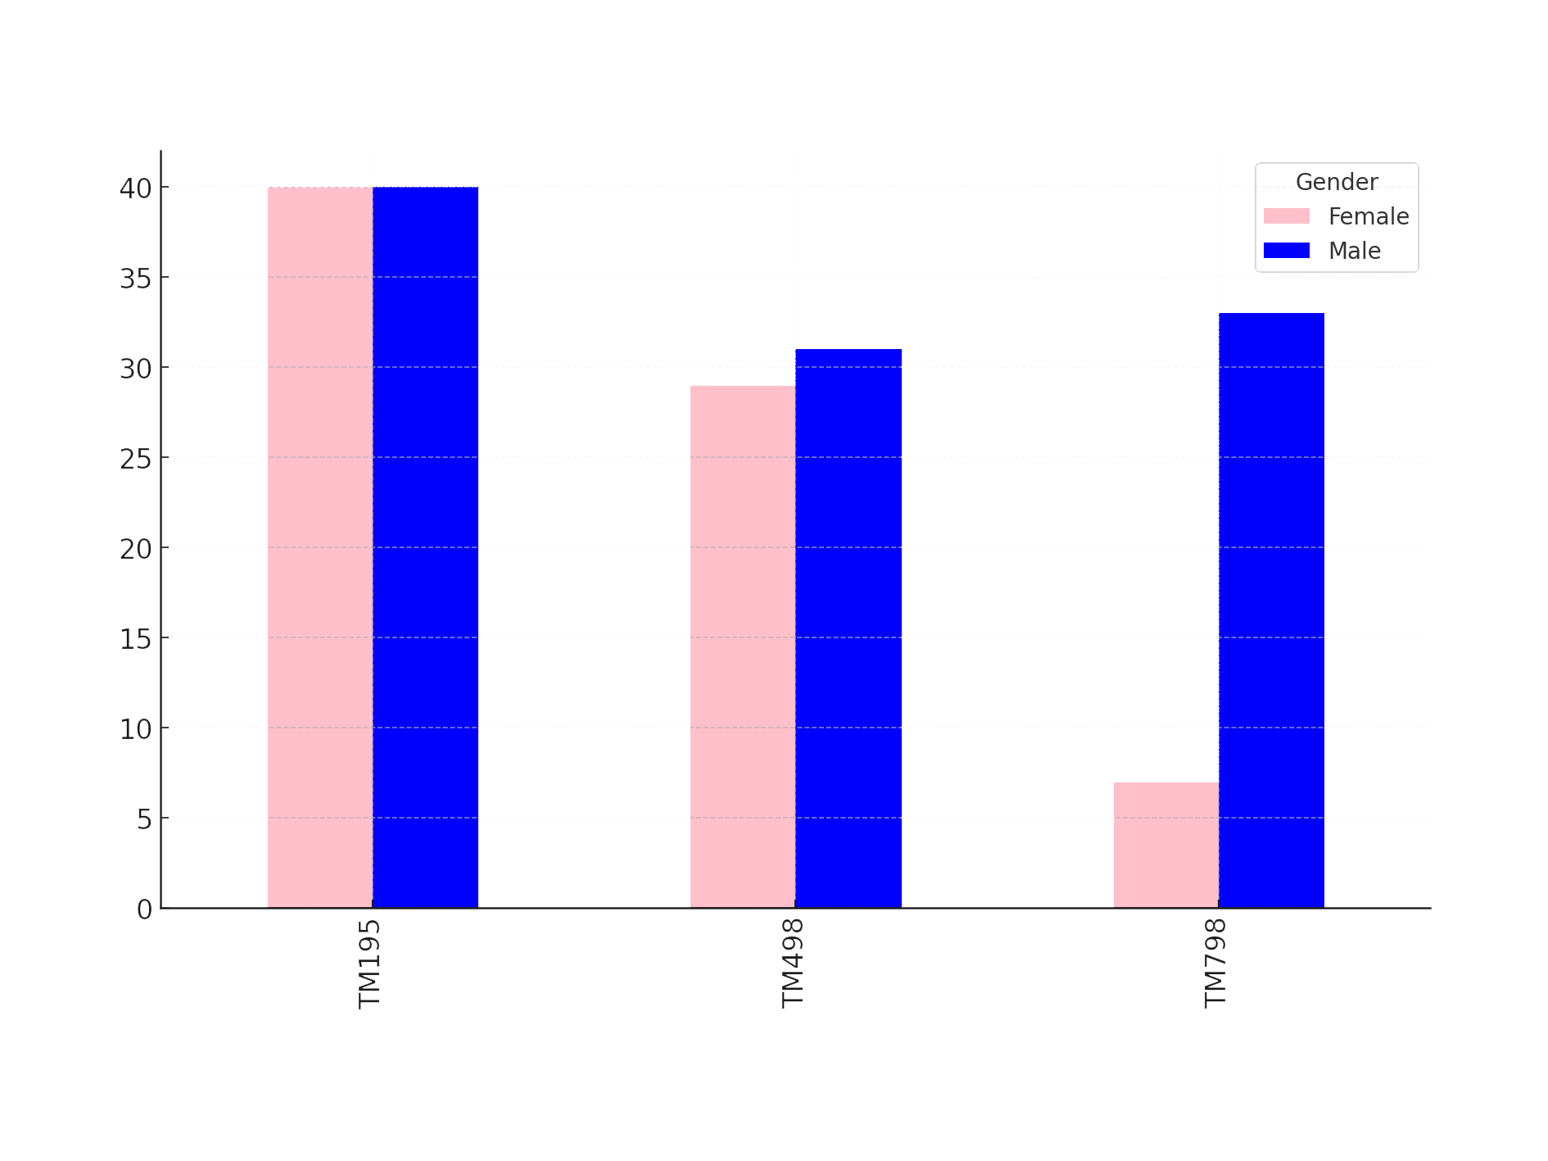
Treadmill Product Analysis
Total purchases per product
Male Vs Female

Slide 13
What Have We Found
Biggest Outlier
Further info
We can see the biggest outlier is TM798 and amongst this being purchases by females
Even amongst females making the same money as Men they still don’t seem to be purchasing

Slide 14
Conclusions

